Slide 1
Advanced Angular
Directives
Lecture 4
By James(Jin) Wang
11/15/2021

Slide 2
Outline
ngFor
ngIf
ngSwitchCase
ngClass
ngStyle
Building custom directives

Slide 3
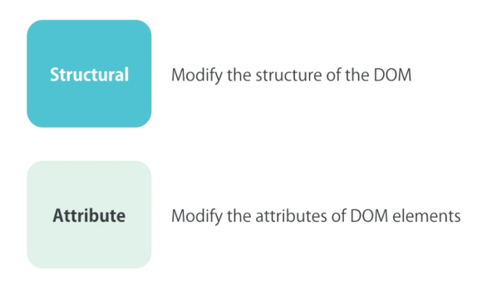
ngIf
  Directives:

Slide 4
ngIf
  Before:
  add:
  <div *ngIf="courses.length > 0">
  List of Courses
  </div>
  After:
  add:
  <div *ngIf="courses.length > 0; else noCourses">
  List of Courses
  </div>

Slide 5
ngIf
  Hidden Property:
  add:
  <div [hidden]="courses.length == 0">
  List of Courses
  </div>

Slide 6
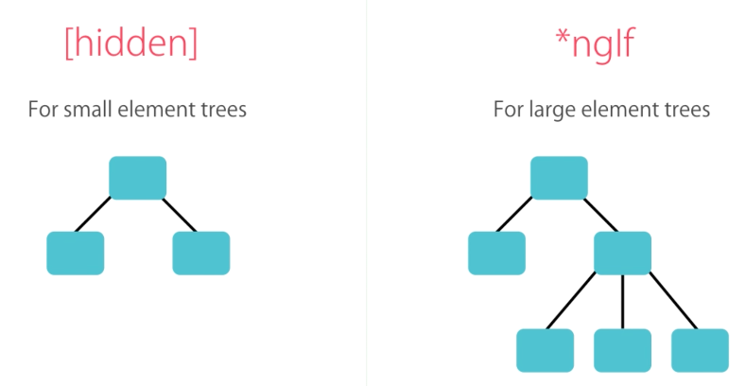
ngIf
  ngIf VS [hidden]:

Slide 7
ngSwitchCase
  ngSwitch:
  add:
  <ul class="nav nav-pills">
  <li [class.active]="viewMode == 'map'"><a (click)="viewMode = 'map'">Map View</a></li>
  <li [class.active]="viewMode == 'list'"><a (click)="viewMode = 'list'">List View</a></li>
  </ul>
  <div [ngSwitch]="viewMode">
  <div *ngSwitchCase="'map'">Map View Content</div>
  <div *ngSwitchCase="'list'">List View Content</div>
  <div *ngSwitchDefault>Otherwise...</div>
  </div>

Slide 8
ngFor
  ngFor:
  add:
  <li *ngFor="let course of courses_2; index as i">
  ngForOf:
  add:
  <li *ngFor="let course of courses_2; even as isEven">
  {{ course.name }} <span *ngIf="isEven">(Even)</span>
  </li>

Slide 9
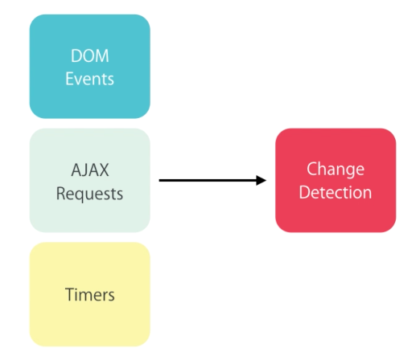
ngFor
  ngFor and Change Detection:
  add:
  <button (click)="onAdd()">Add</button>

Slide 10
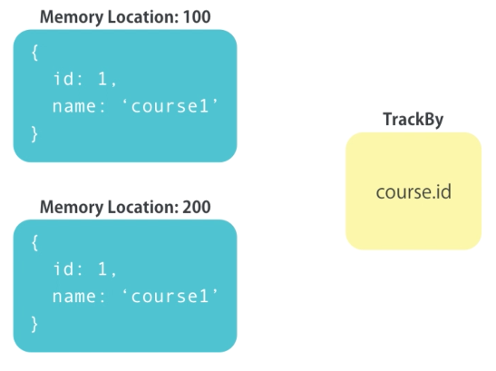
ngFor
  ngFor and Trackby:
  add:
  <li *ngFor="let course of courses_3; trackBy: trackCourse ">

Slide 11
ngClass
  ngClass:
  add:
  <span class="glyphicon" [class.glyphicon-star]="isFav" [class.glyphicon-star-empty]="!isFav"
  [ngClass]="
  {
  'glyphicon-star': isFav,
  'glyphicon-star-empty': !isFav
  }
  "
  (click)="toggleFav()"></span>

Slide 12
ngStyle
  ngStyle:
  add:
  <button
  [ngStyle]="{
  'backgroundColor': canSave ? 'blue' : 'gray',
  'color': canSave ? 'white' : 'black'
  }"
  >Save 2</button>

Slide 13
ngStyle
  Safe Traversal Operator:
  add:
  <span>{{ task.assignee?.name }}</span>

Slide 14
Custom Directives
  Creating Custom Directives:
  ng g d input-format
  add:
  @HostListener('blur') onBlur() {
  let value: string = this.el.nativeElement.value;
  if(this.format === 'lowercase') {
  this.el.nativeElement.value = value.toLowerCase();
  } else {
  this.el.nativeElement.value = value.toUpperCase();
  }
  }

Slide 15
Summary

